Slide 1

Apollinaria
Arlyapova
portfolio

Slide 2
Experience
About me
Skills
I am an industrial design student from Tomsk and currently studying at the Tomsk polytechnic University. I have a great passion for design and craftsmaking.
Decor studio Decor studio Raspberry cat Pinkslon Тоmsk Тоmsk Decorator Decorator Sep 2014 - May 2016 Jul 2015 - March 2016
Cafe Atmosferas Prague Illustrator Apr 2015 - Jul 2016
Ability to work in various programs such as
• Corel Draw, • Solid Works,
• Adobe Photoshop, • Art Cam,
•Adobe InDesign • Sketch Up
Also work with different materials such as clay, watercolors, inks, etc.

Slide 3
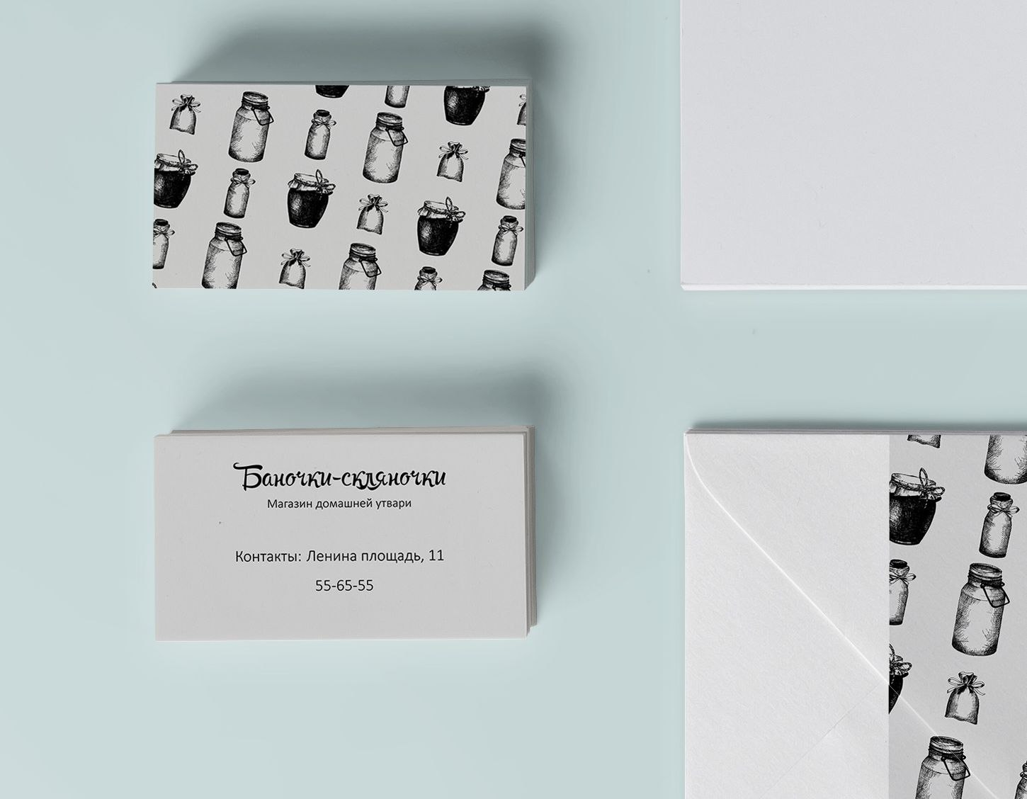
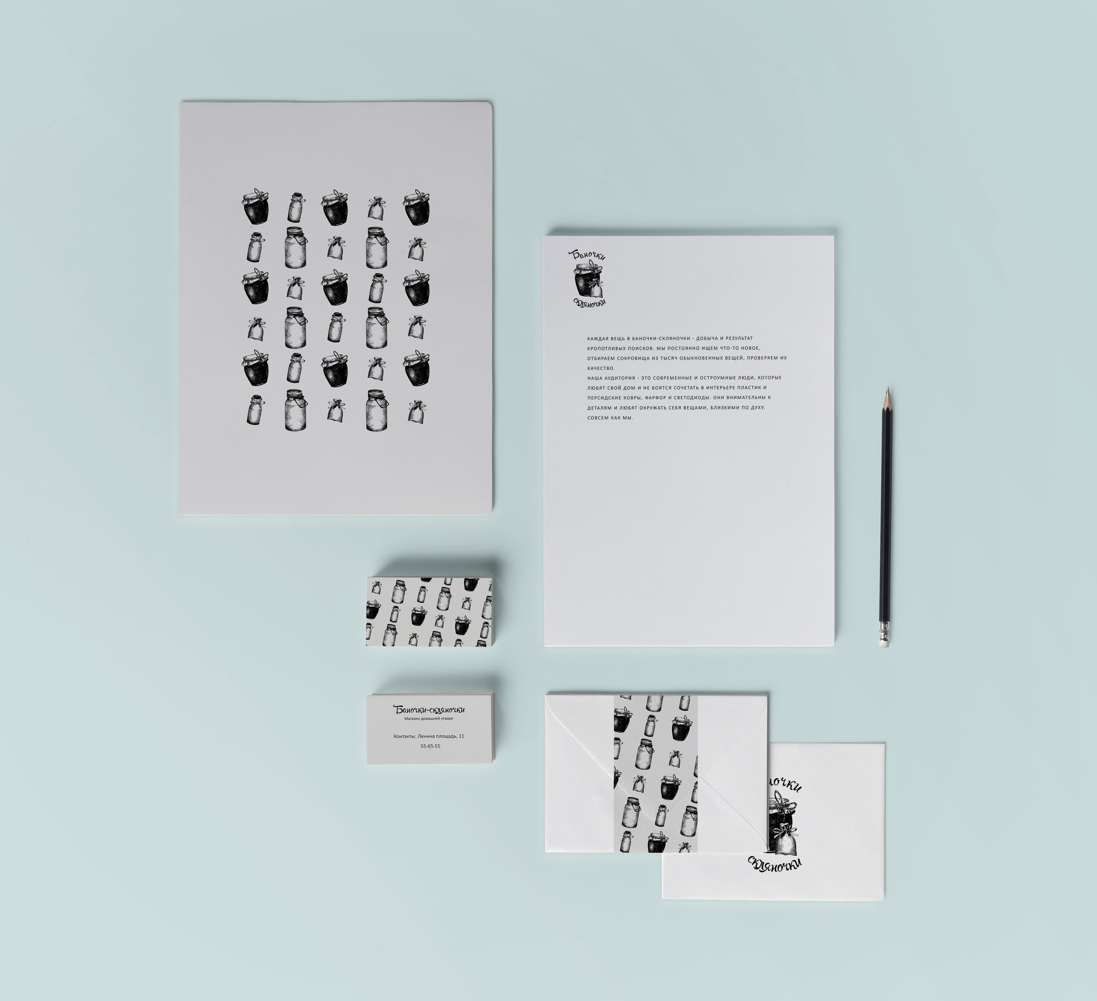
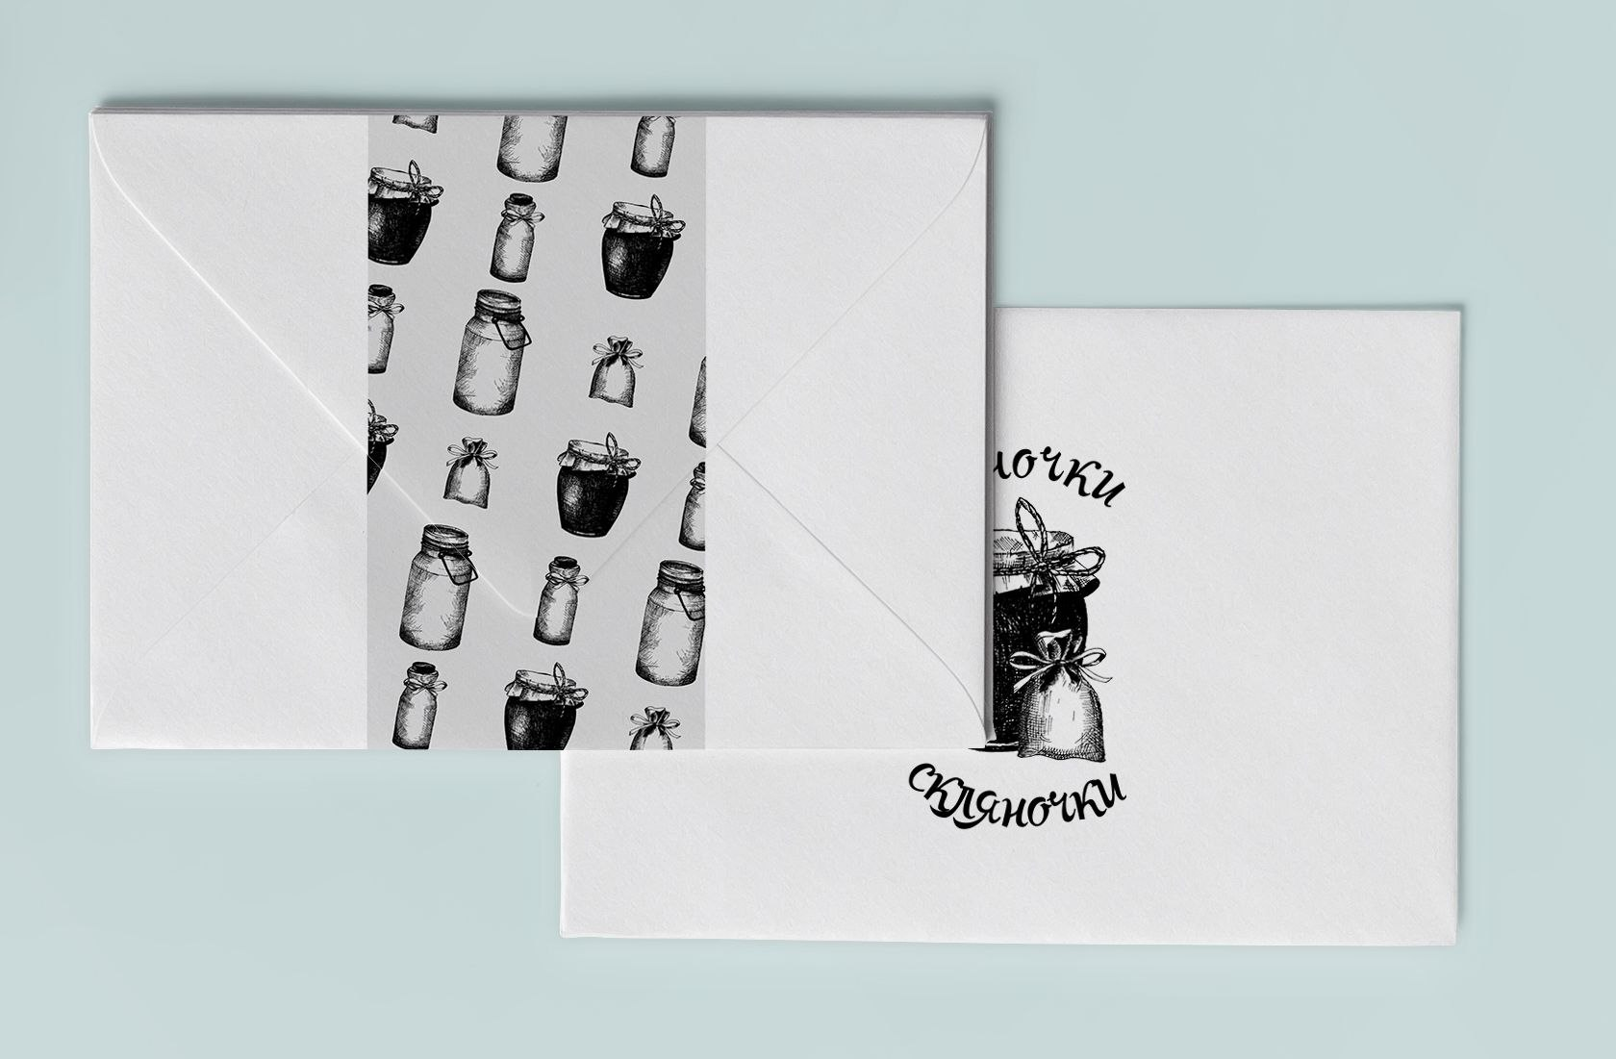
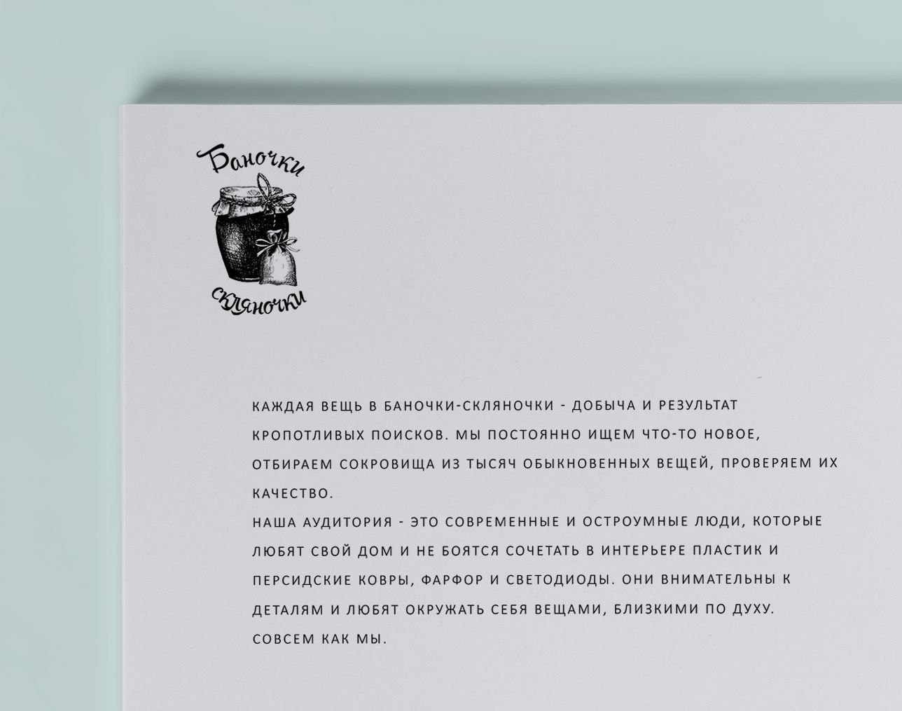
Projects brand identity
Brand identity for cute store of pots and pans, 2014

Slide 4
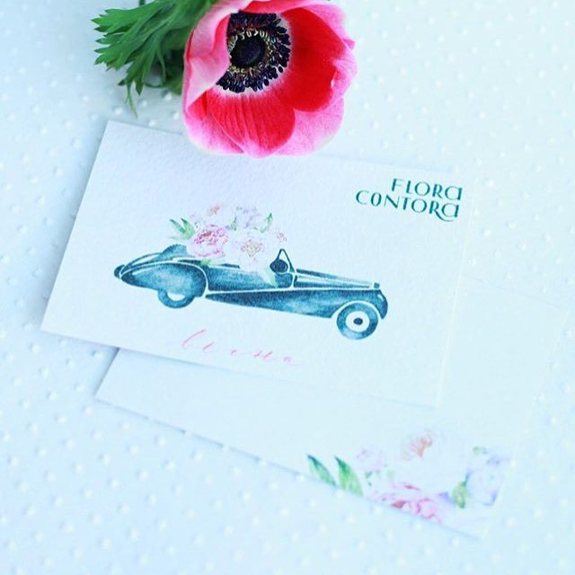
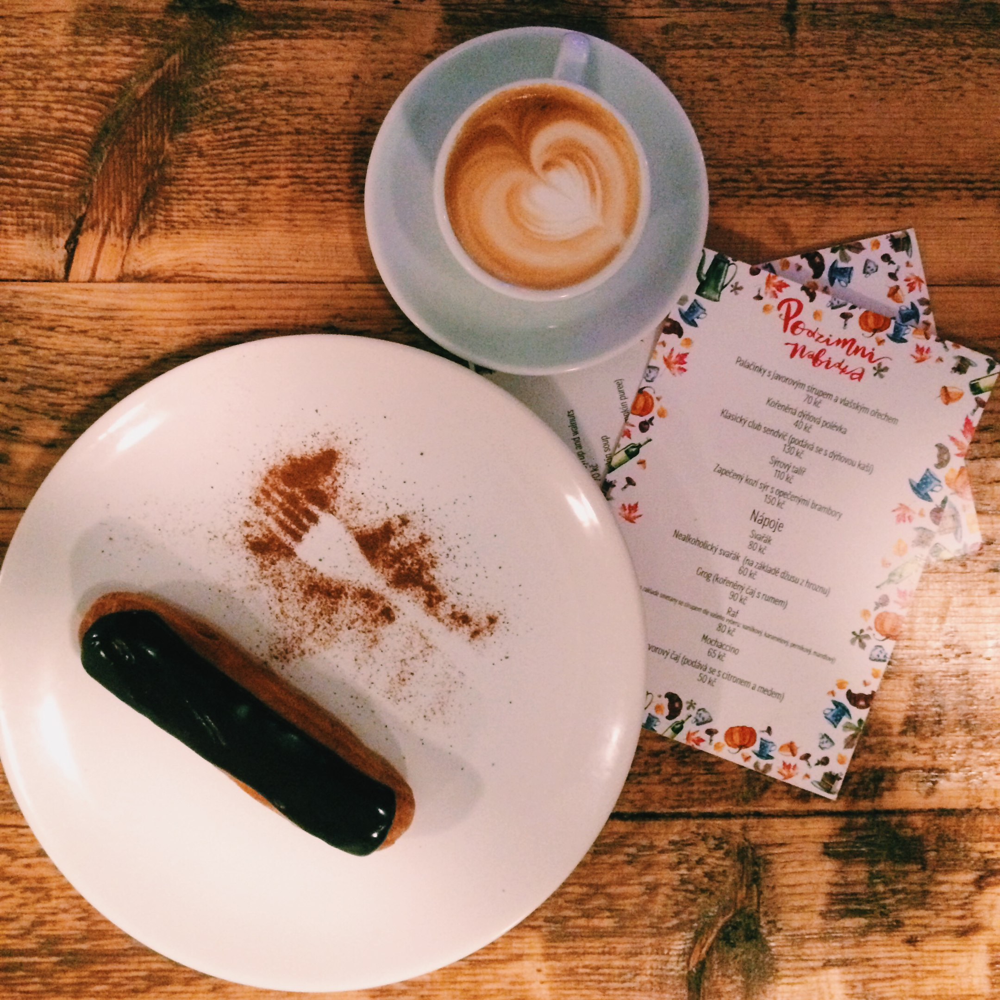
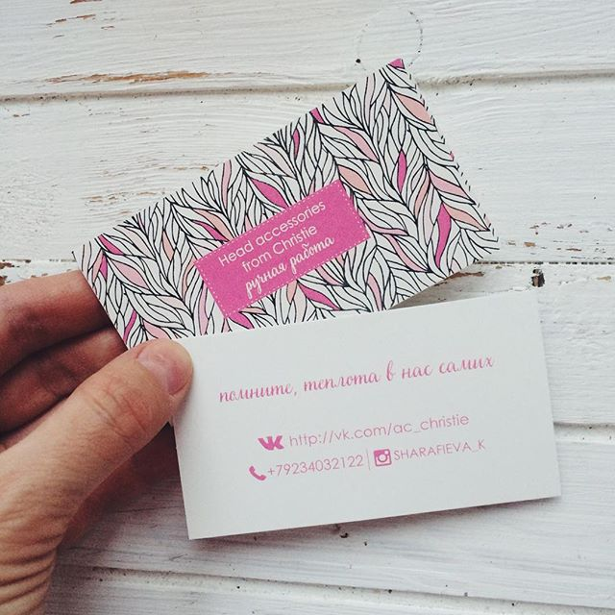
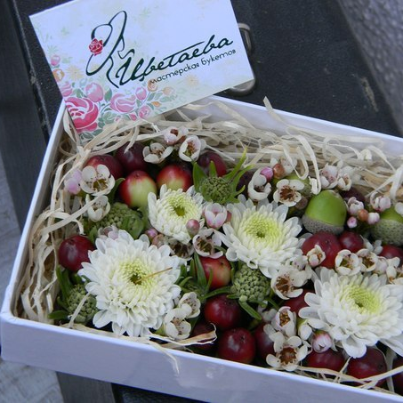
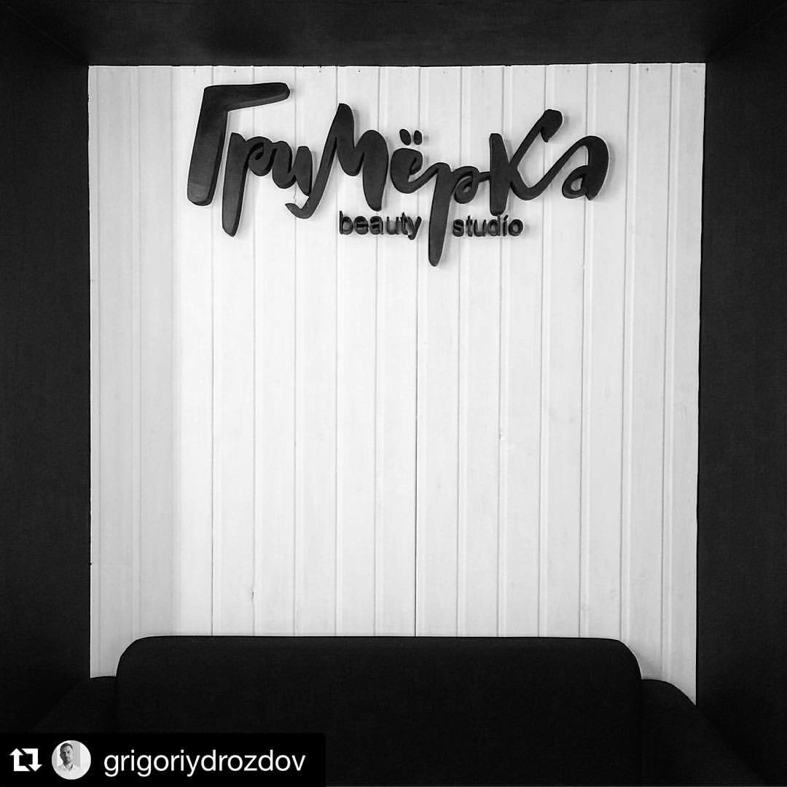
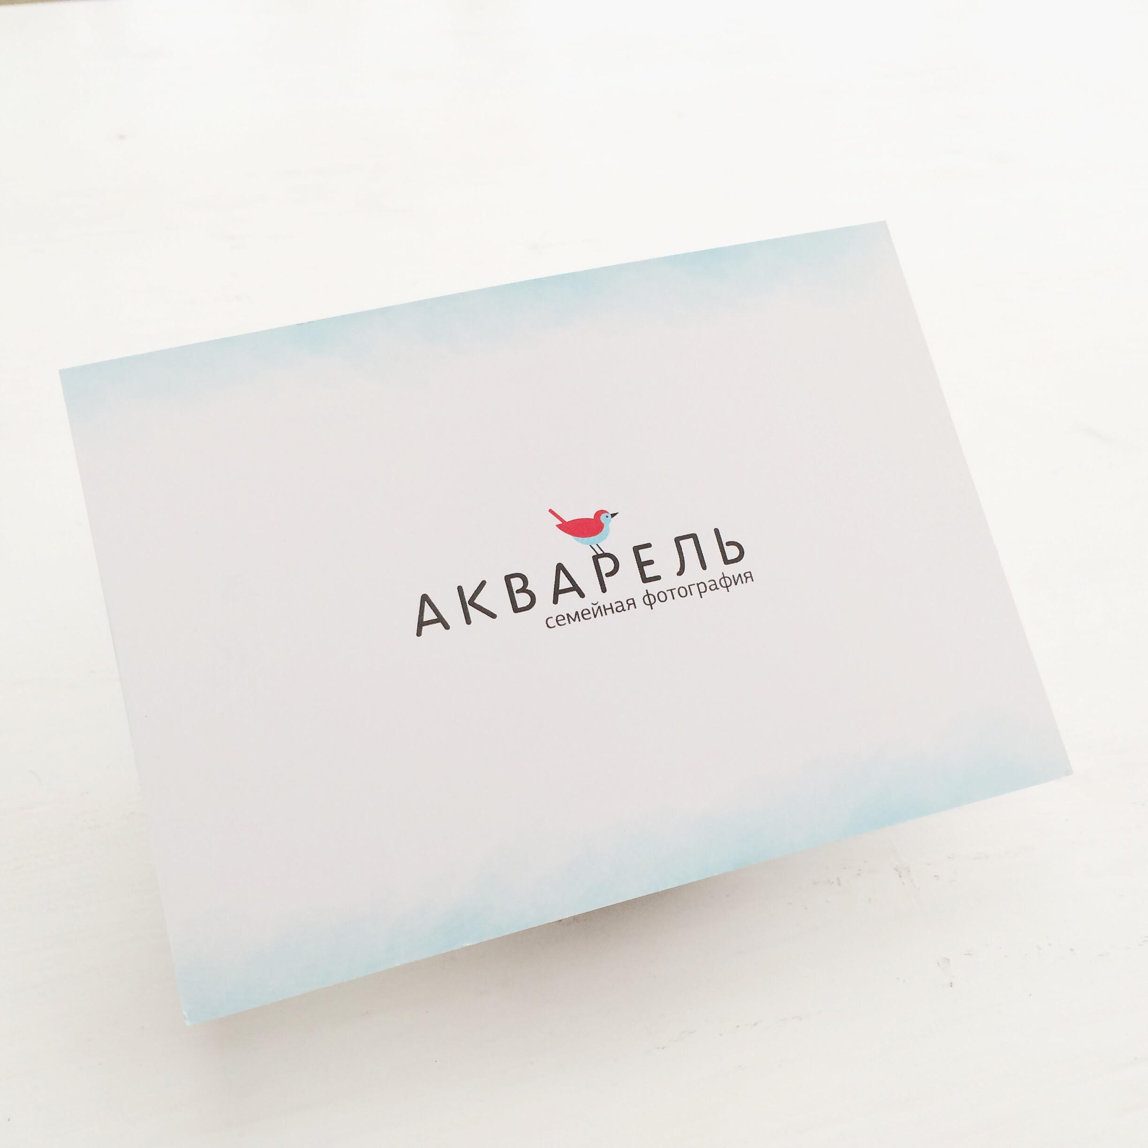
sgdfg
Projects branding
card for flower shop,2016
card for flower shop,2014

Slide 5
Projects branding
Design for mobile app, that will remind you expiration date of food in your frige
And also suggest you some recipes

Slide 6
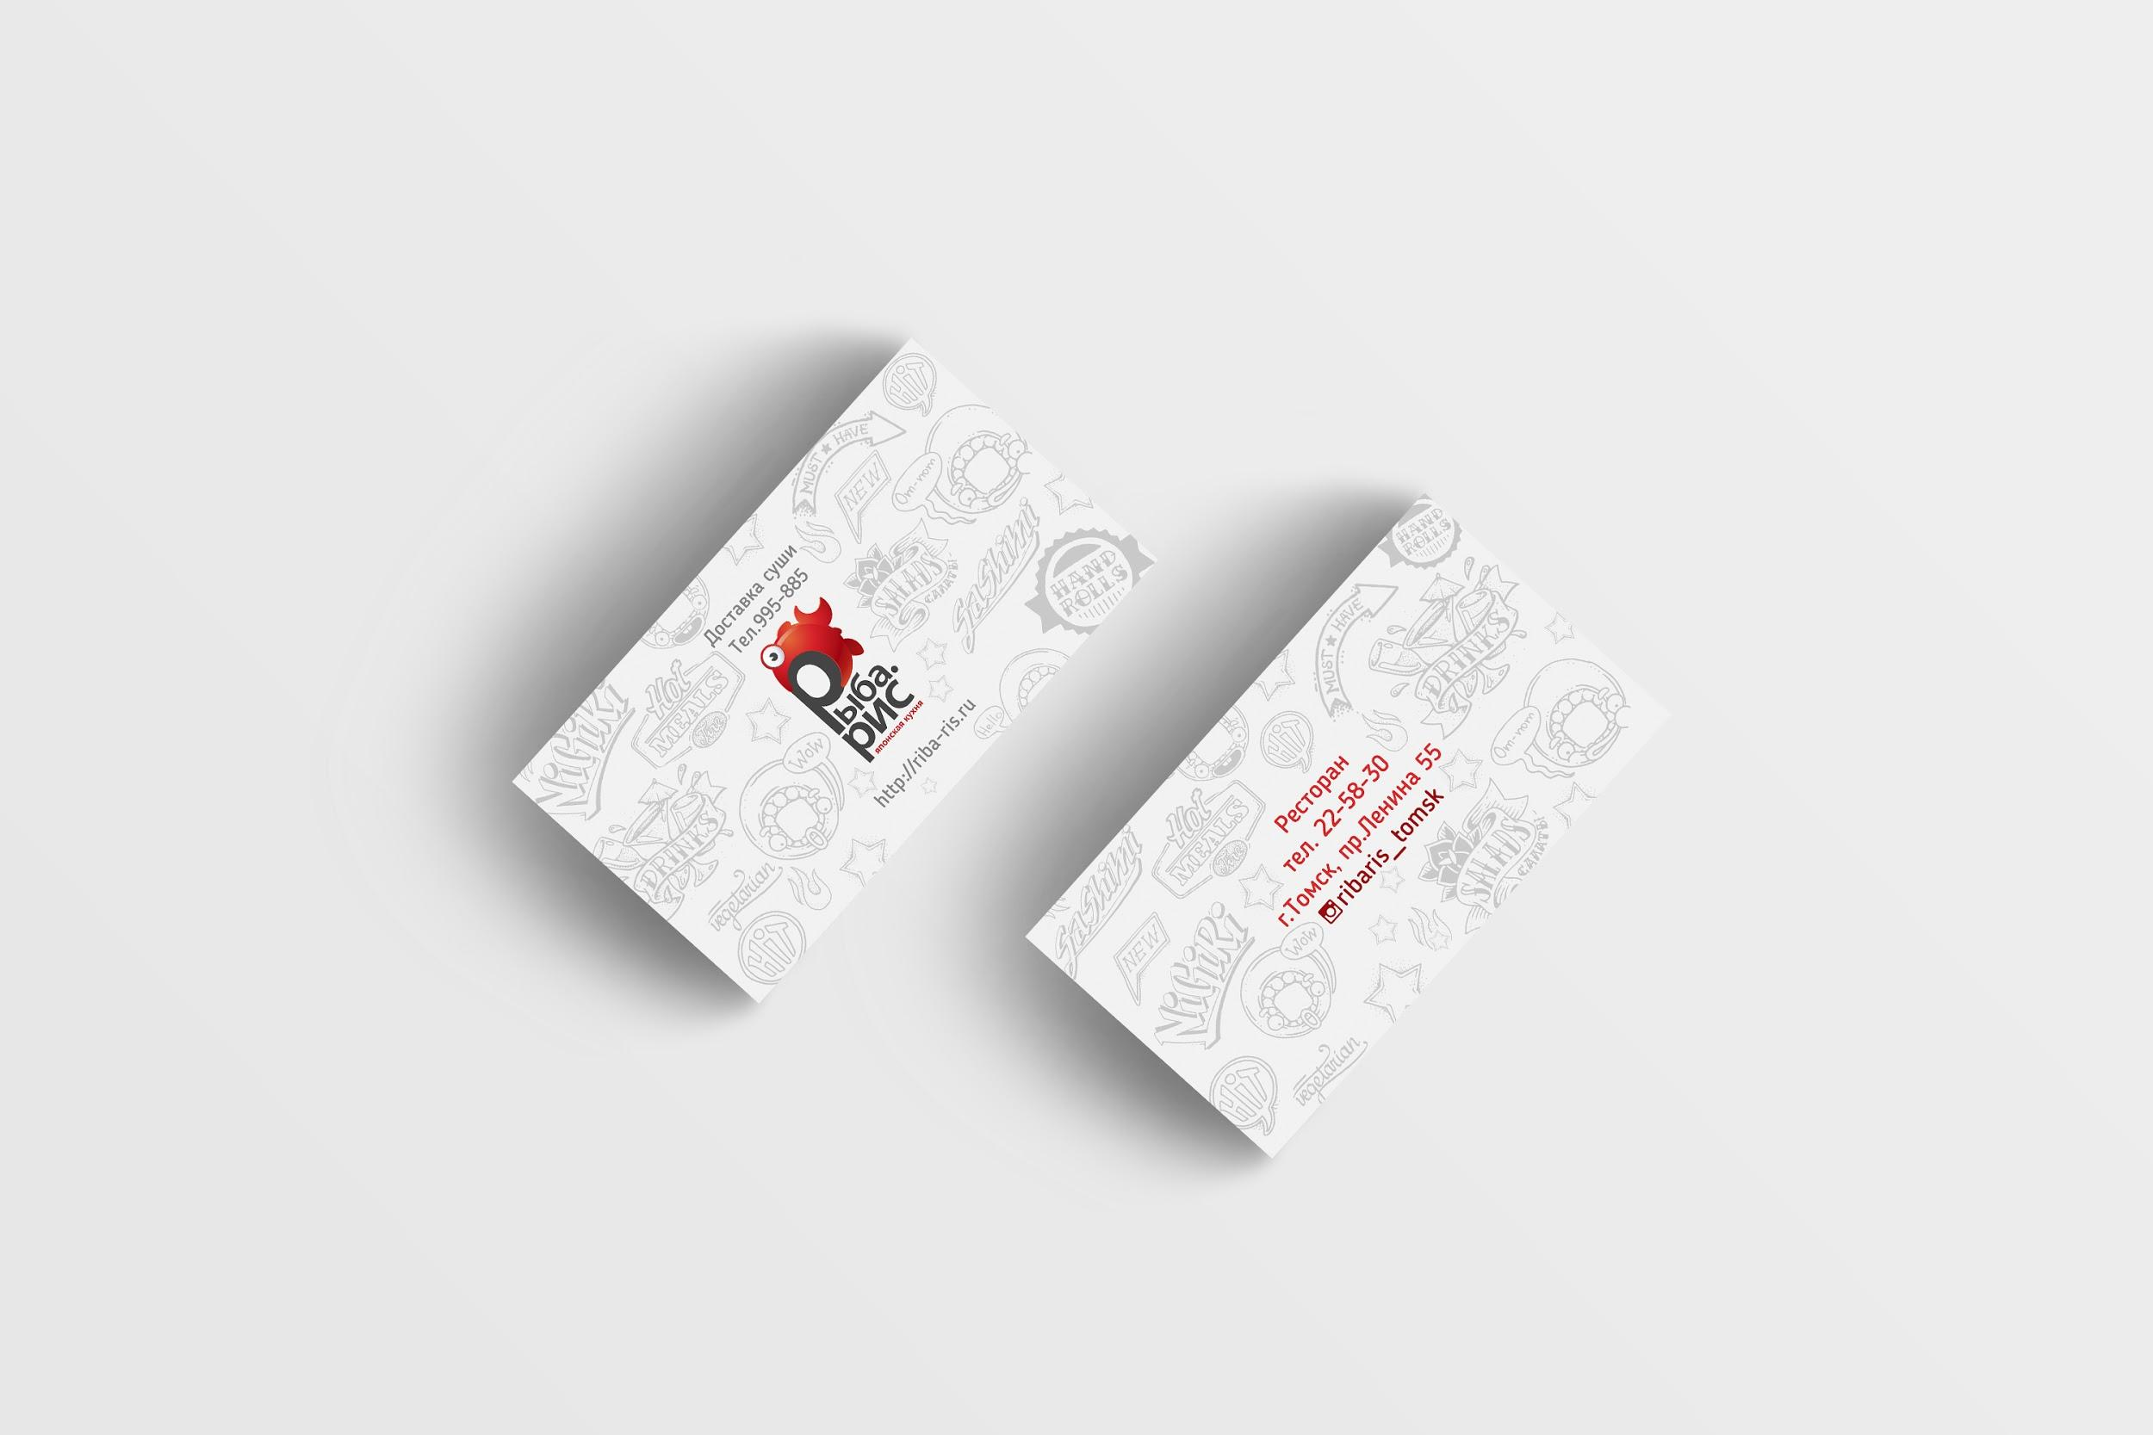
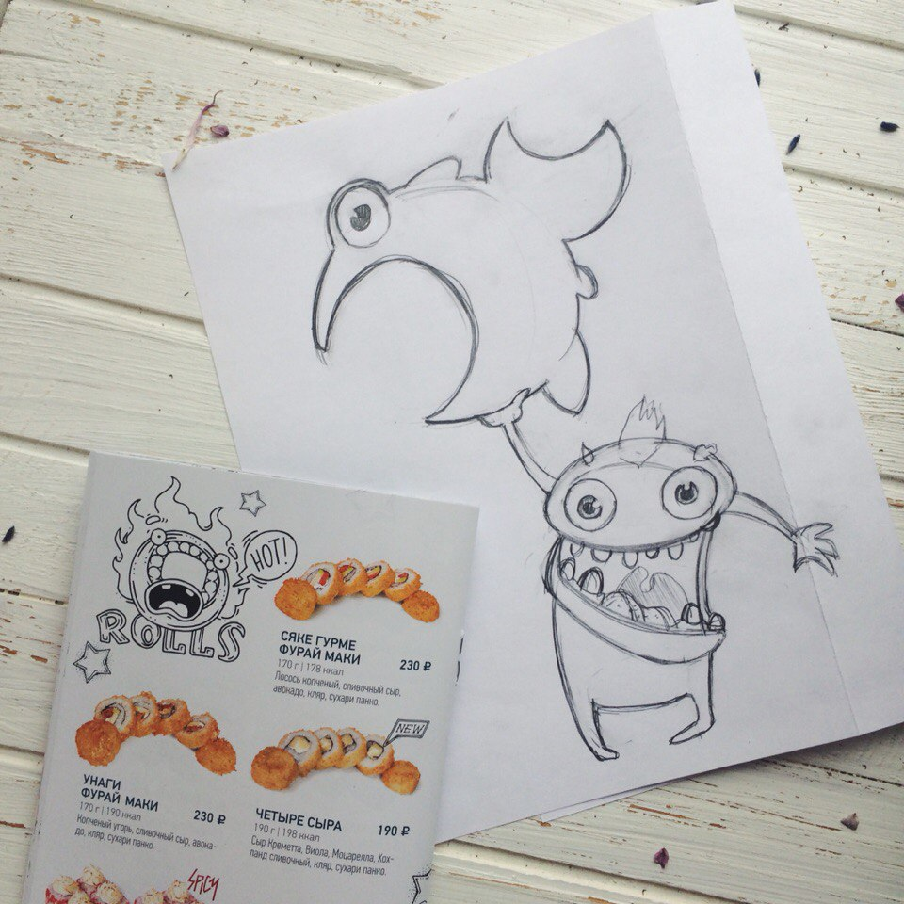
Projects branding
Cafe of chinese cuisine business cards,
2015

Slide 7
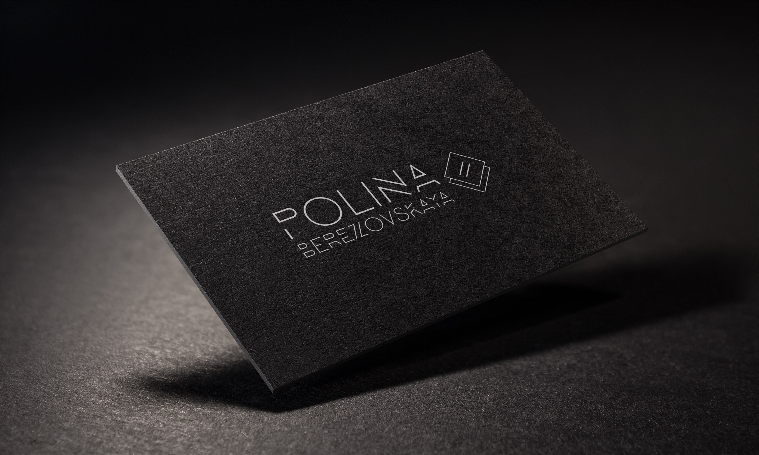
Projects branding
Business card & logotype for designer of clothes,
2015

Slide 8
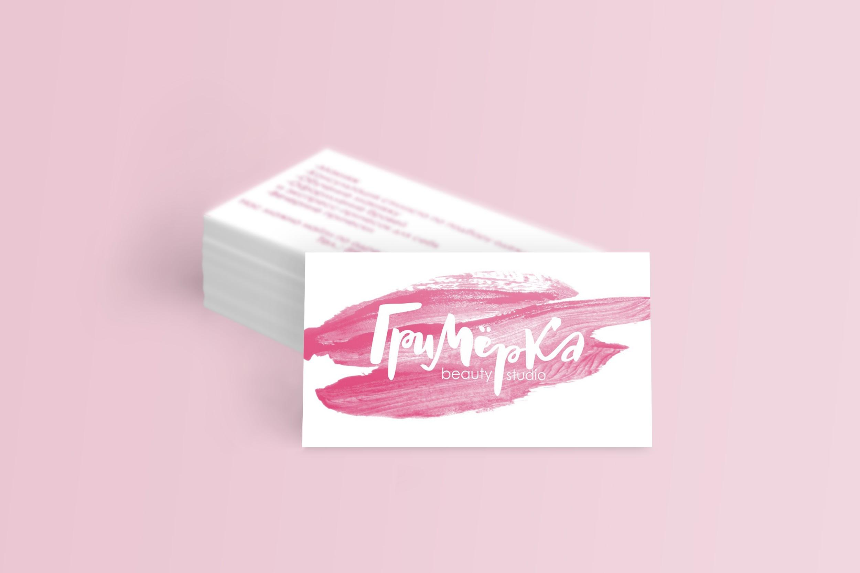
Projects branding
Business card & logotype for beauty studio,
2015

Slide 9
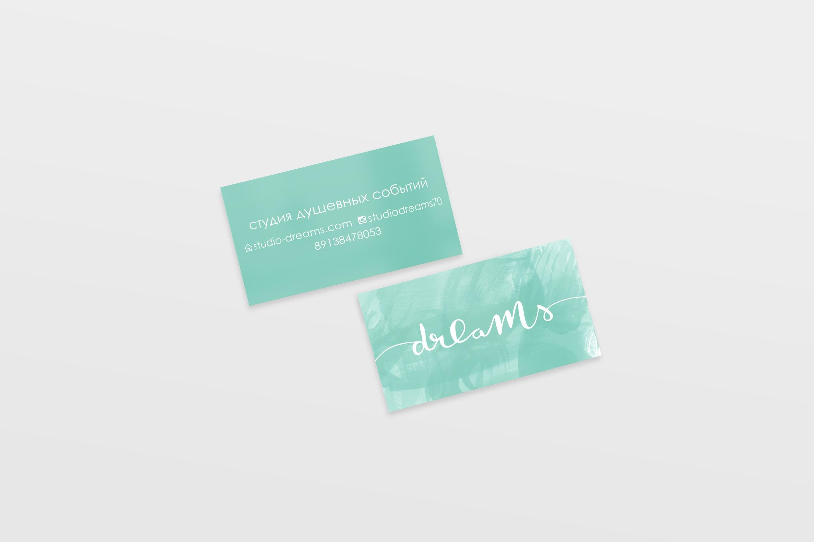
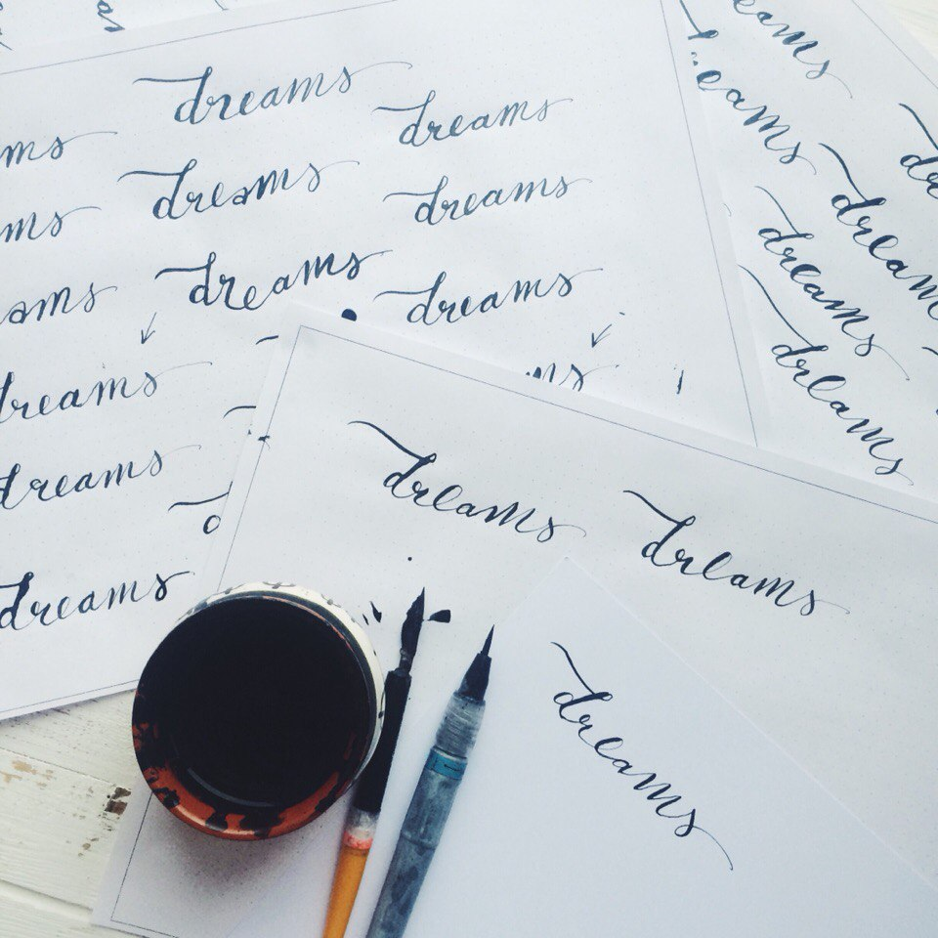

Projects branding
Business card &
decor studio logo,
2015

Slide 10
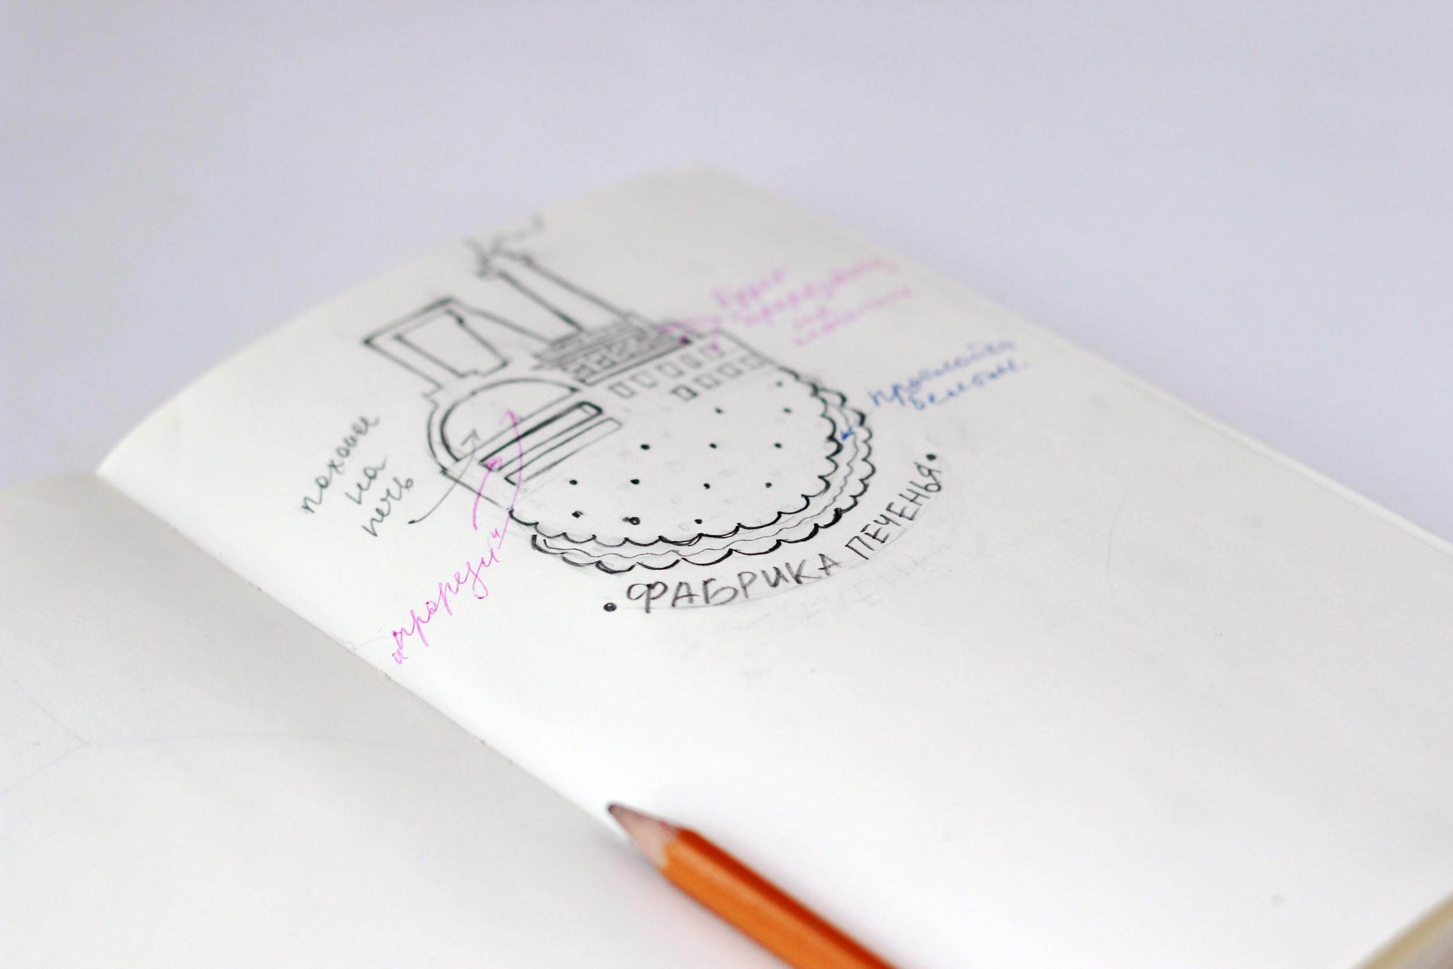
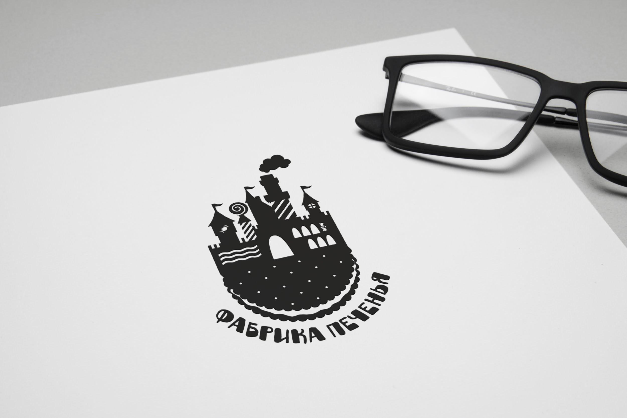
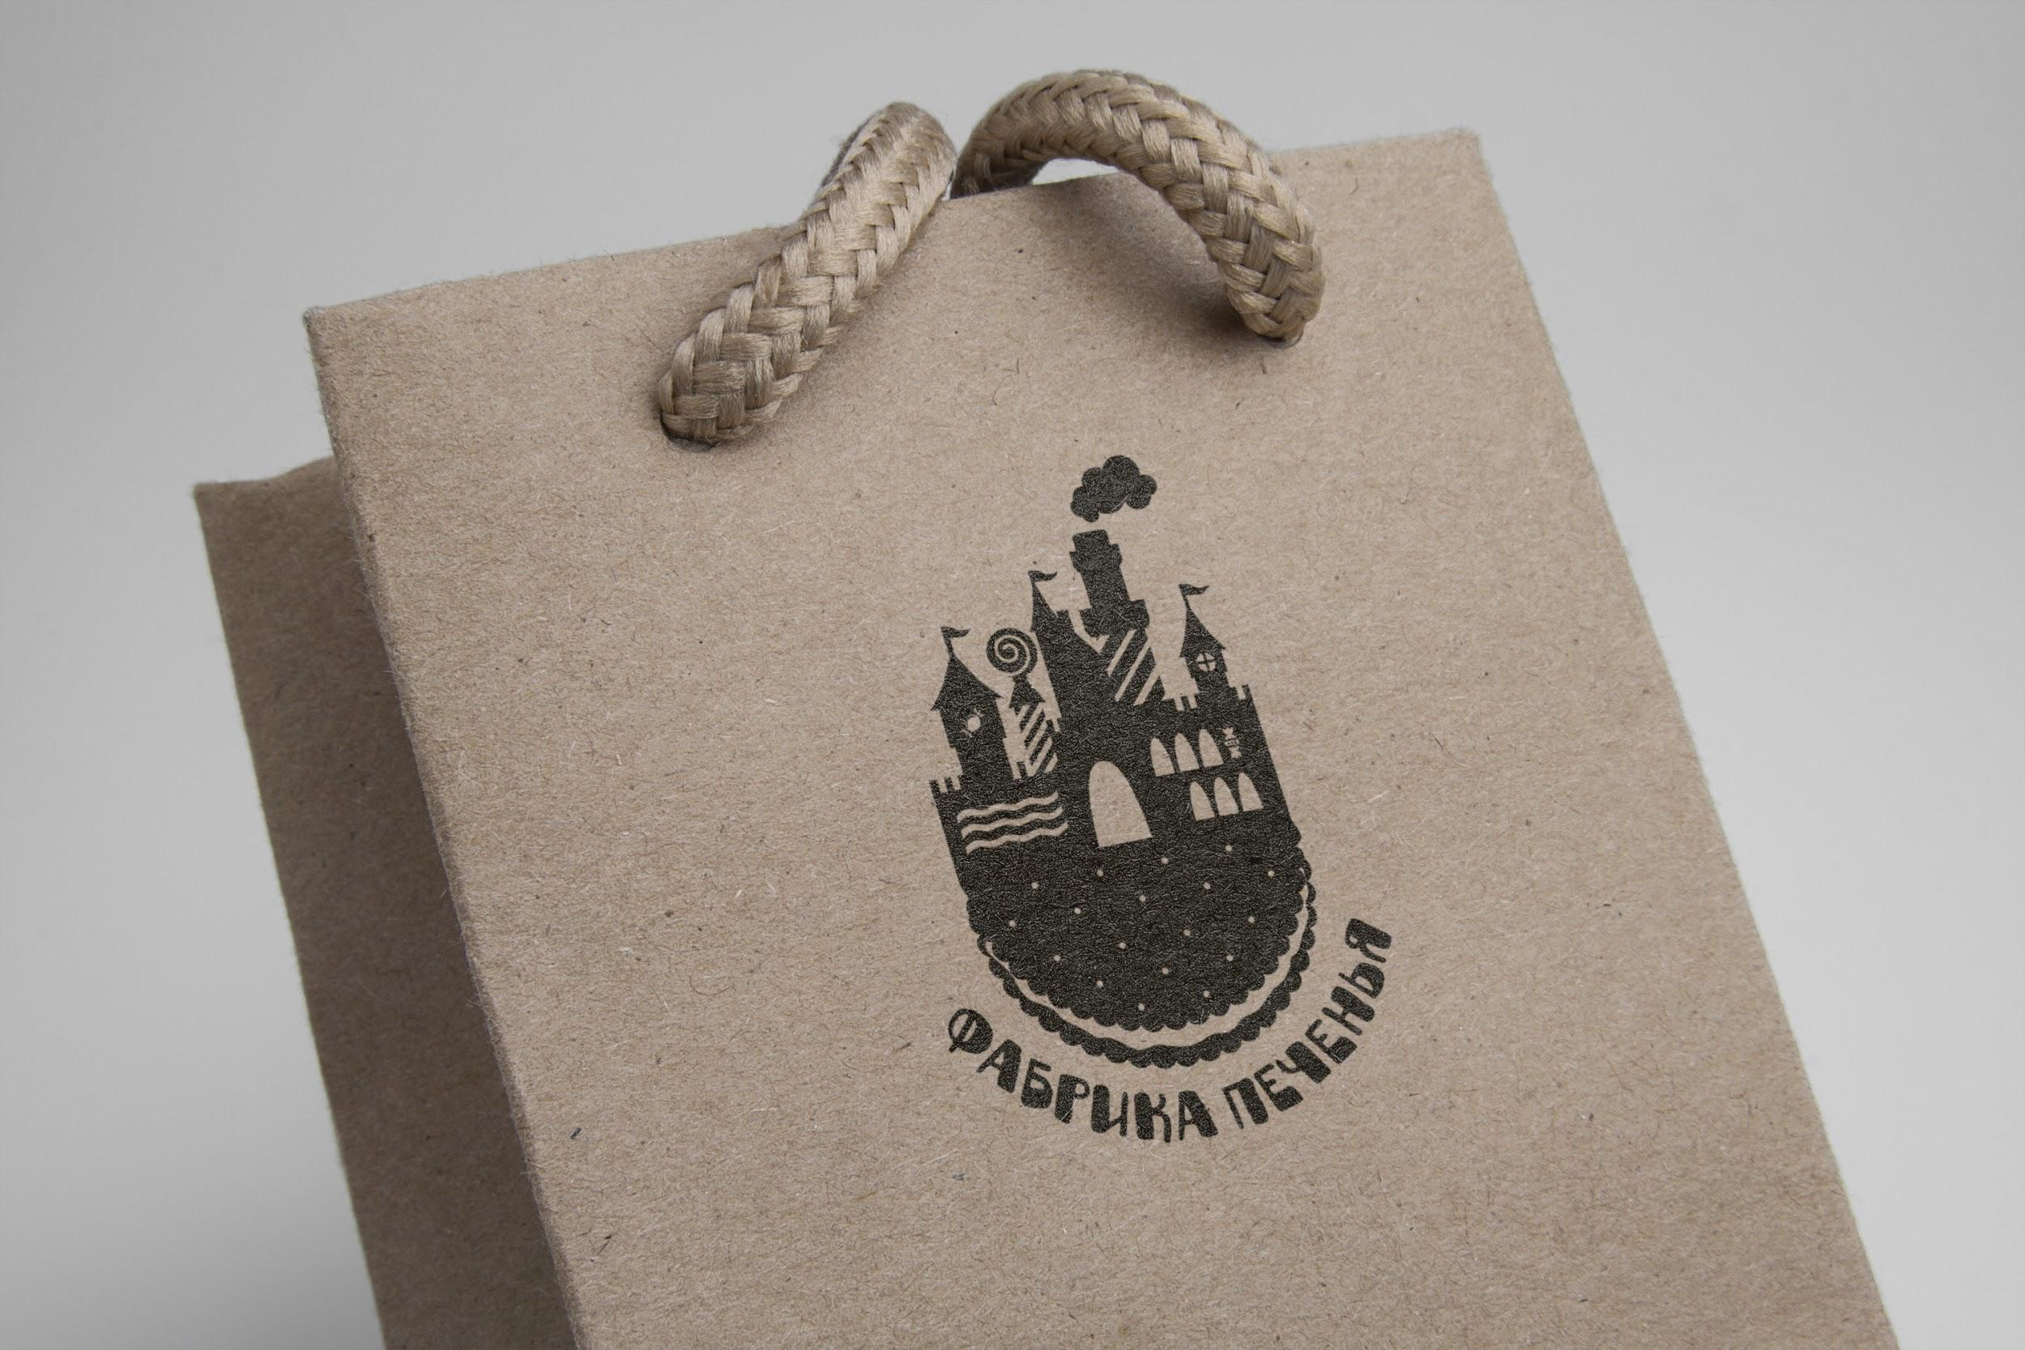
Projects branding
Cookies store logotype,
2016

Slide 11
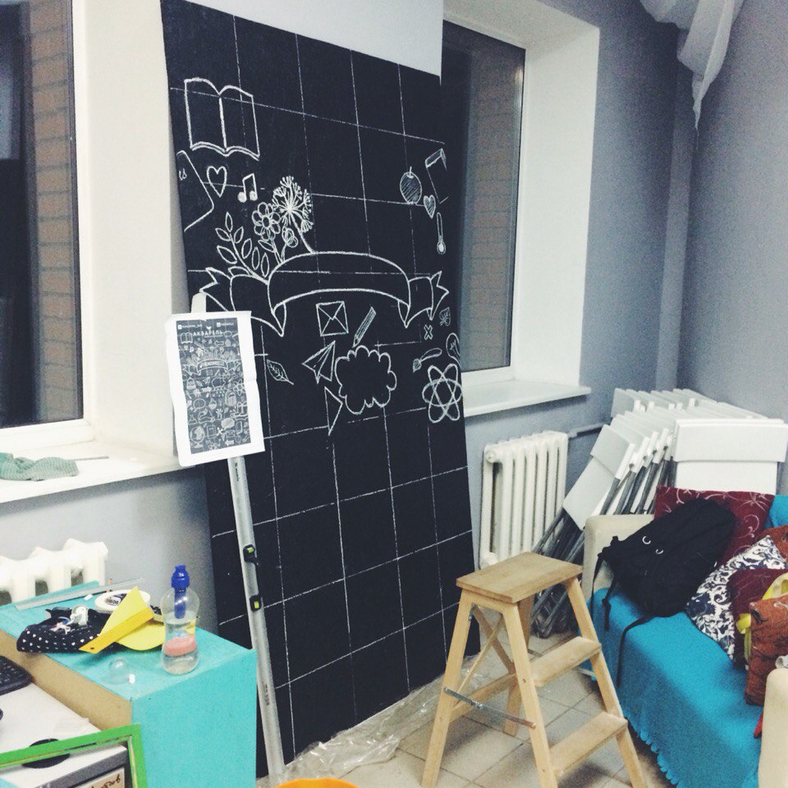
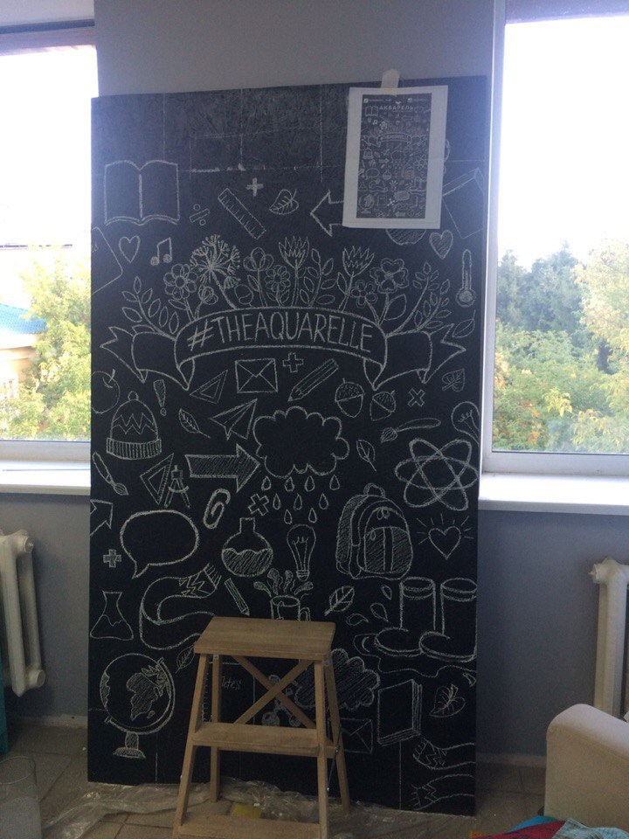


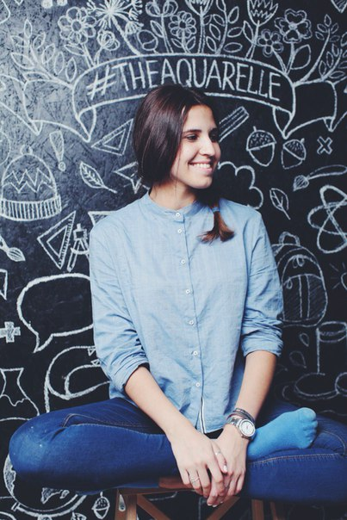
Projects branding

Slide 12




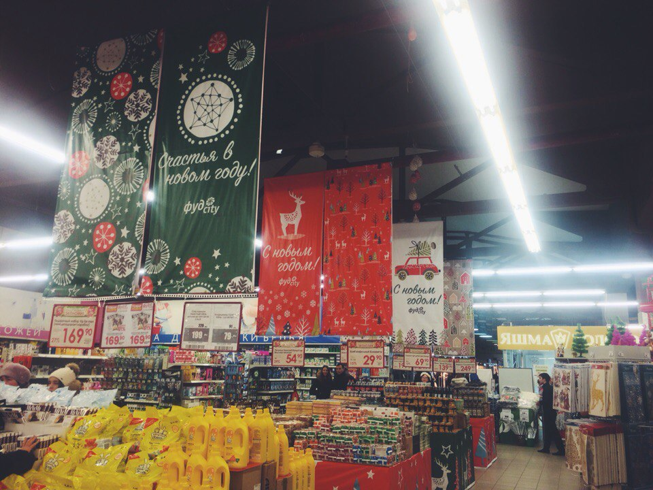




Projects branding
Christmas
banners illustration,
pattern design,
2015

Slide 13
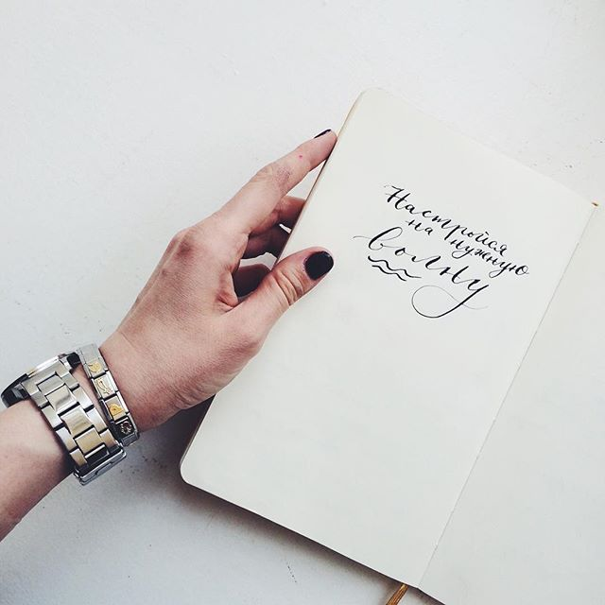
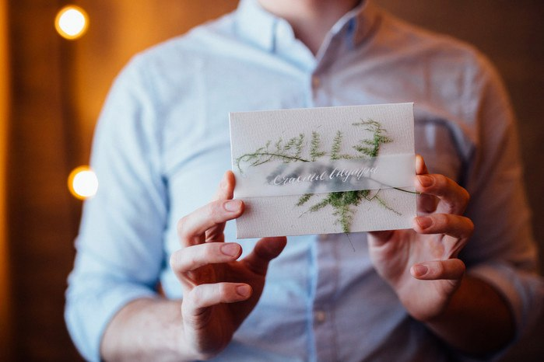
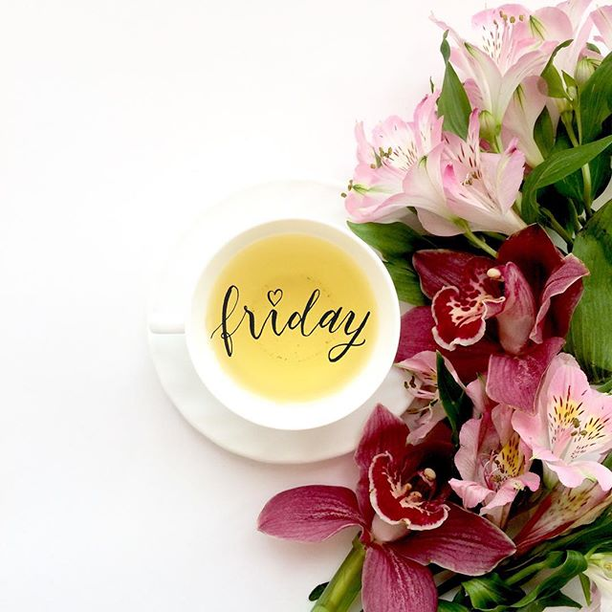
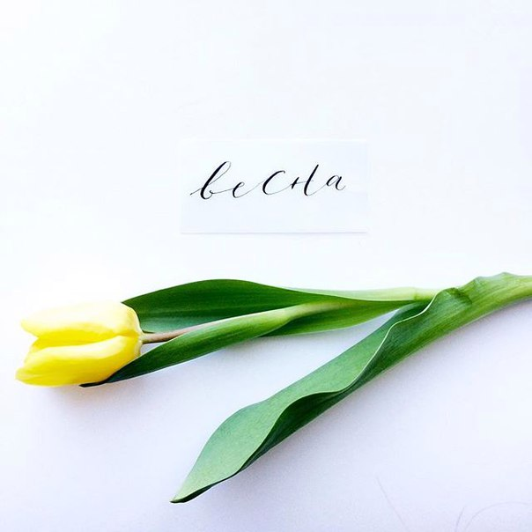
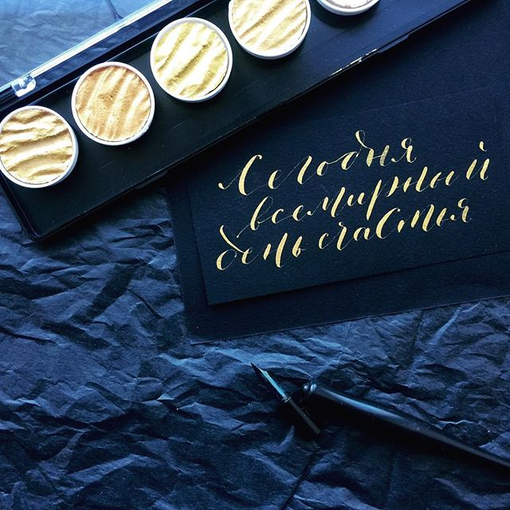
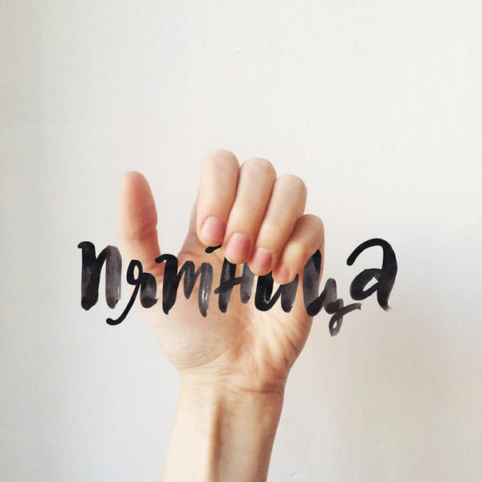
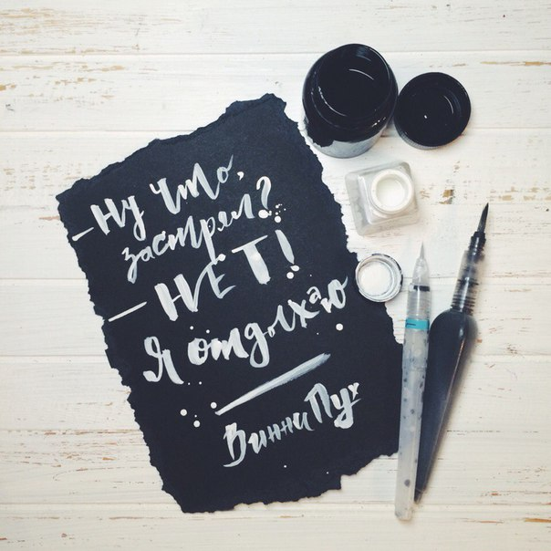
Projects Calligraphy

Slide 14
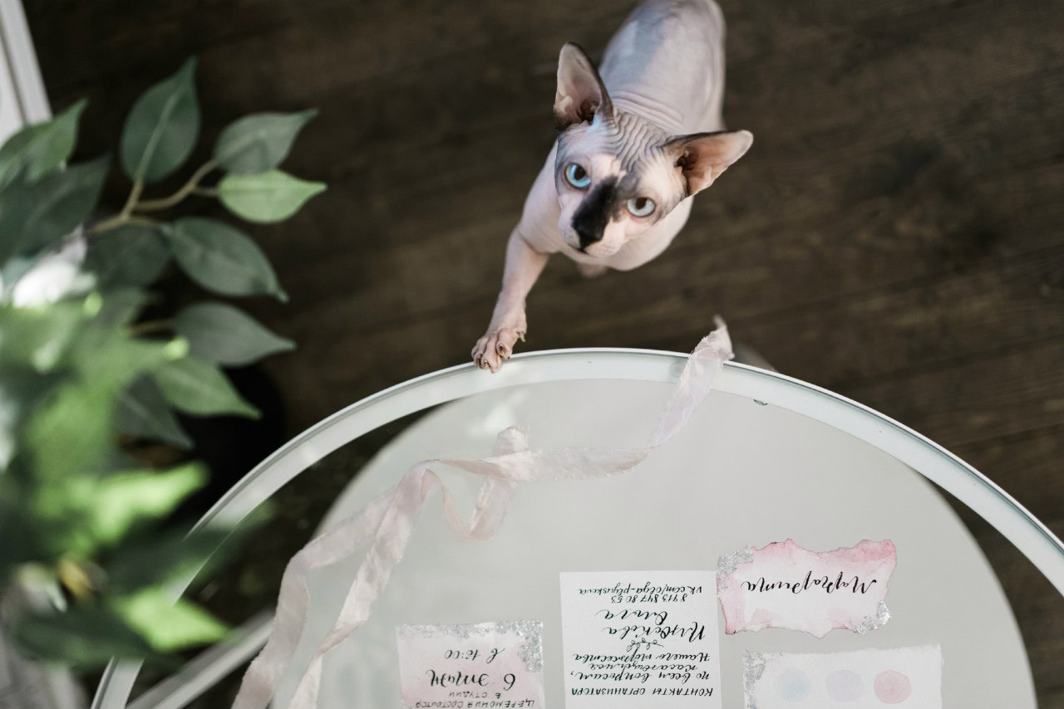
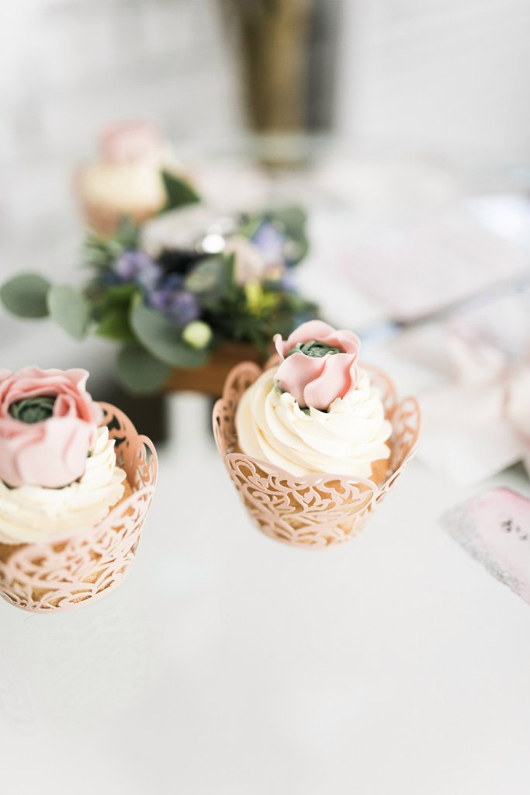
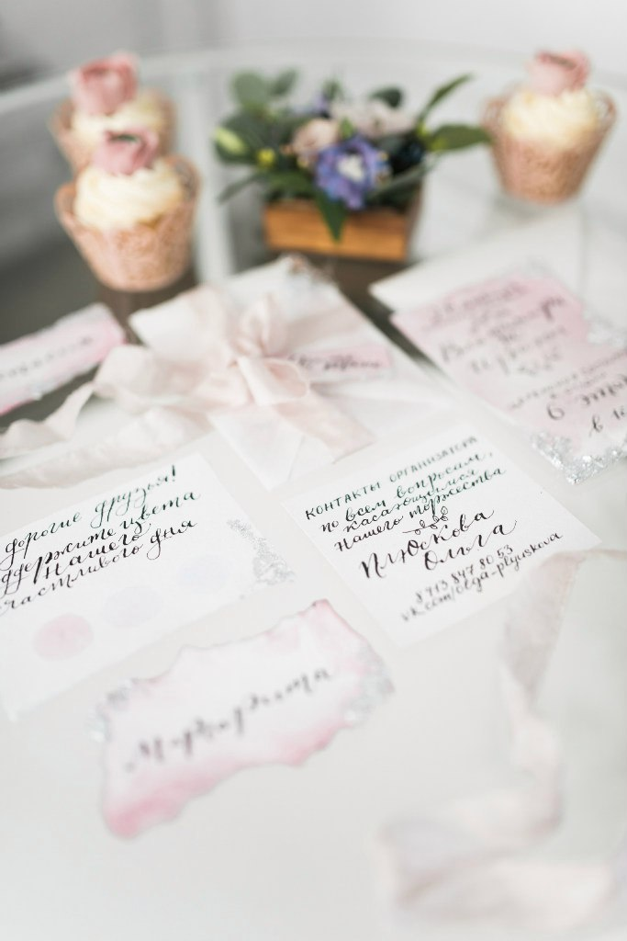
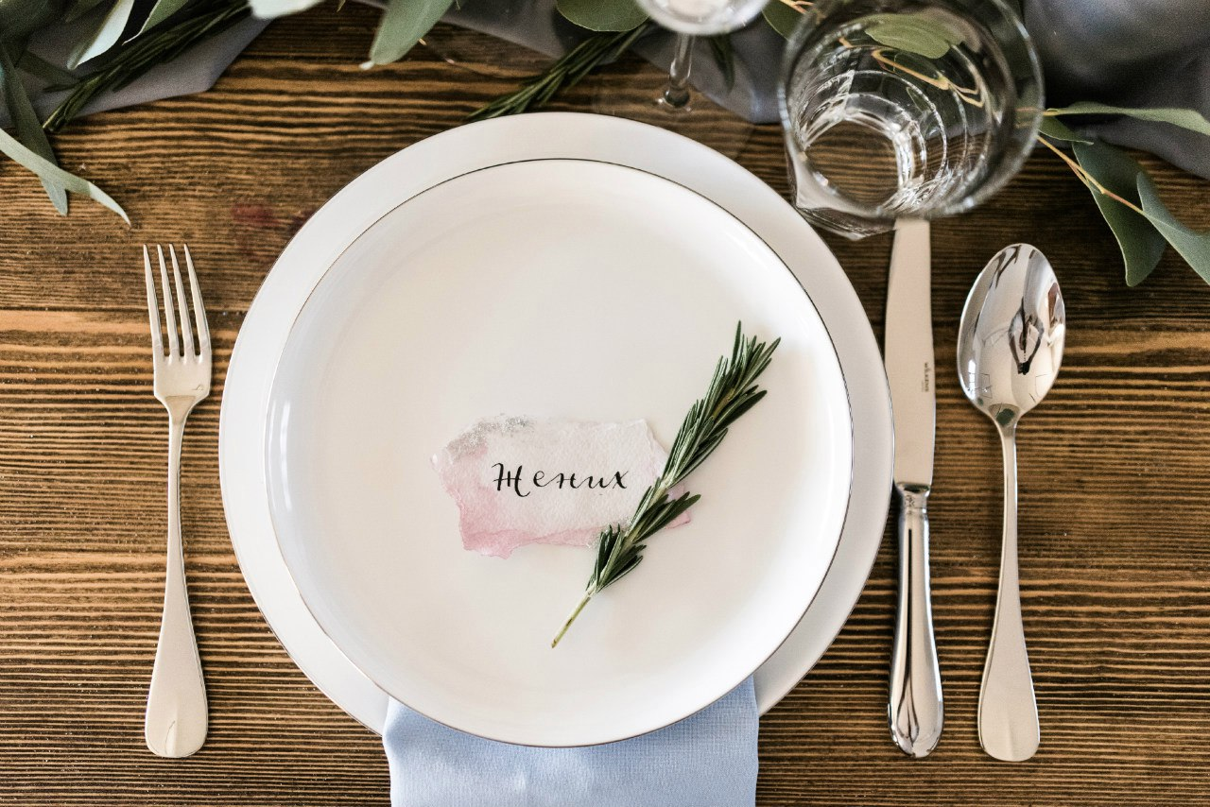
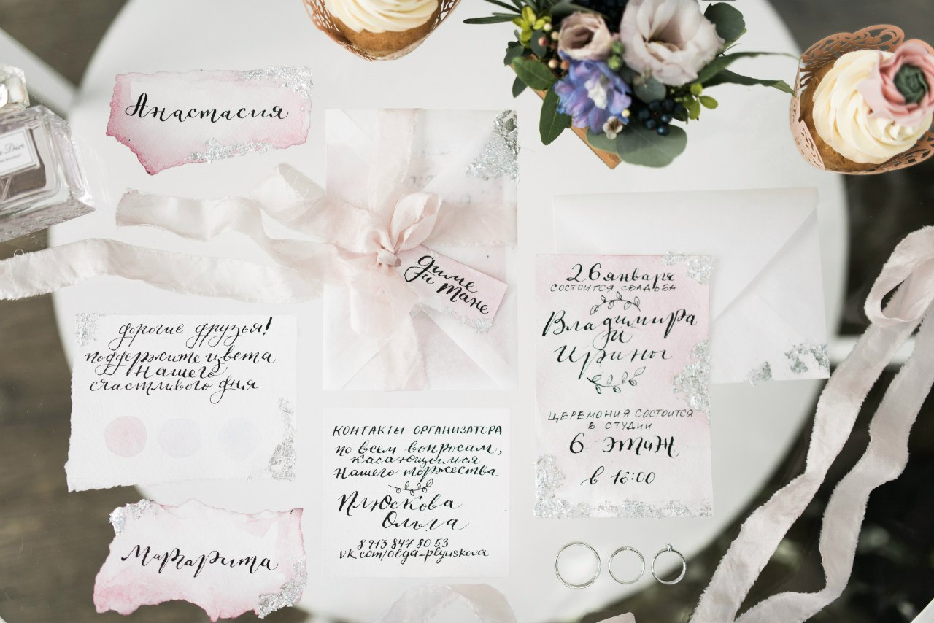
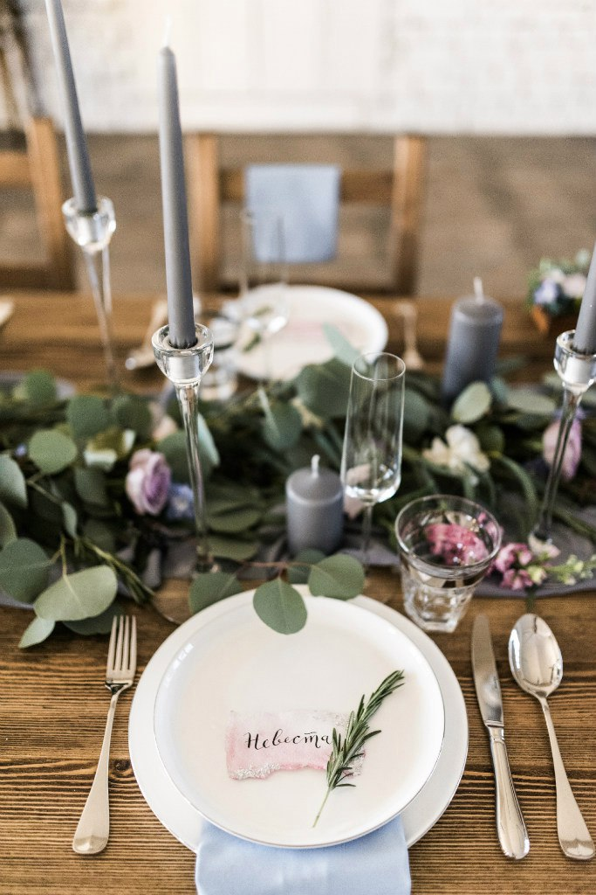

Pantone’s colours 2016 season project
Projects Wedding polygraphy

Slide 15
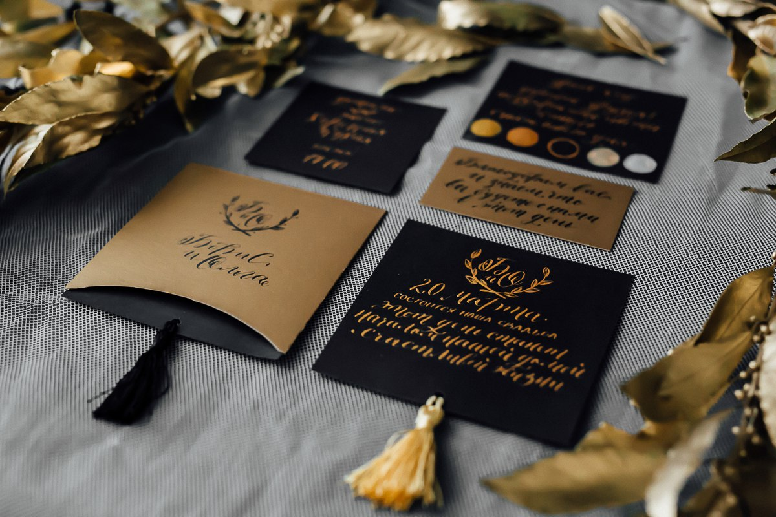
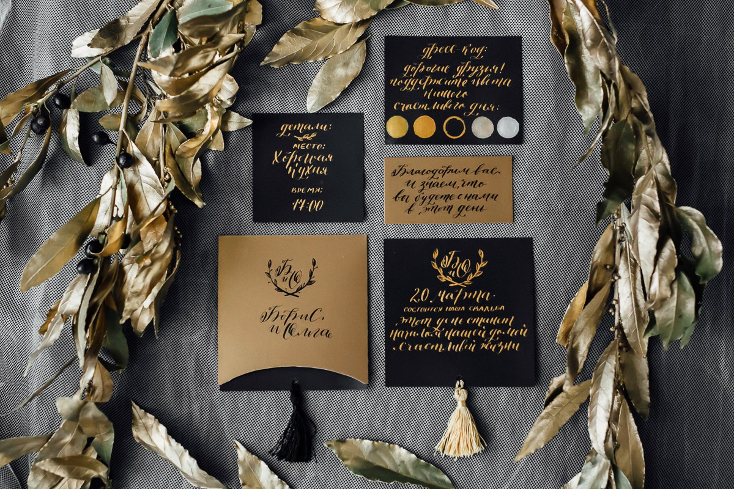
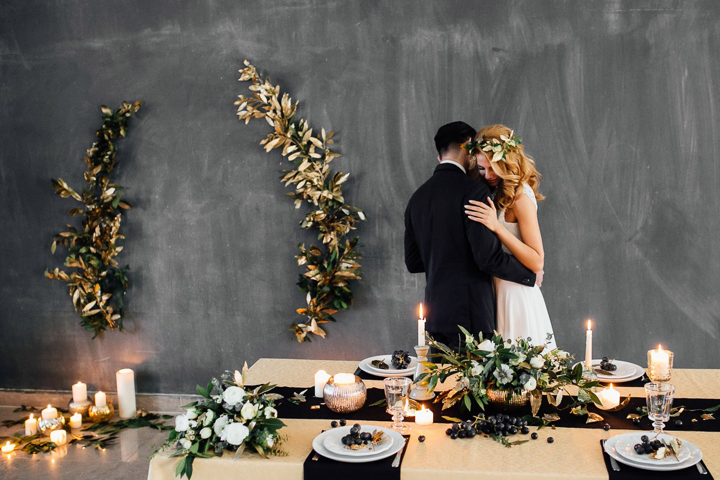
Projects Wedding polygraphy
Gold and black colors project,
2016

Slide 16
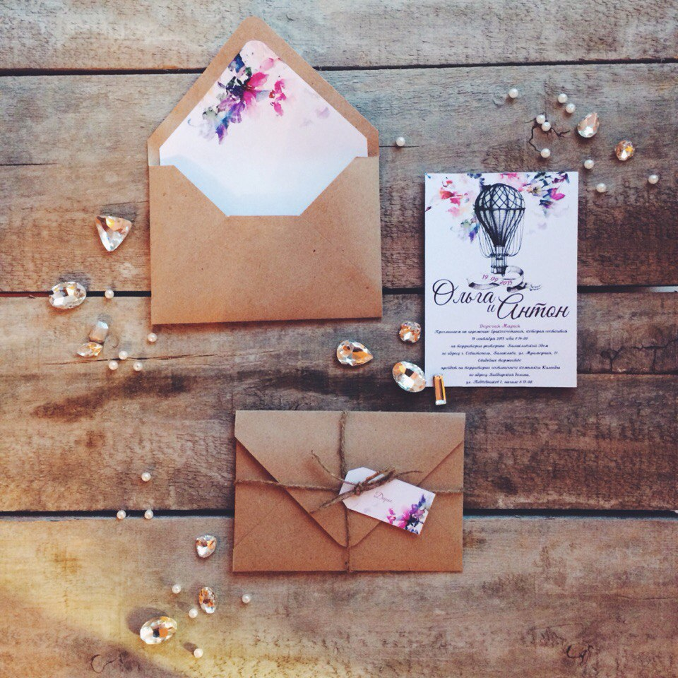
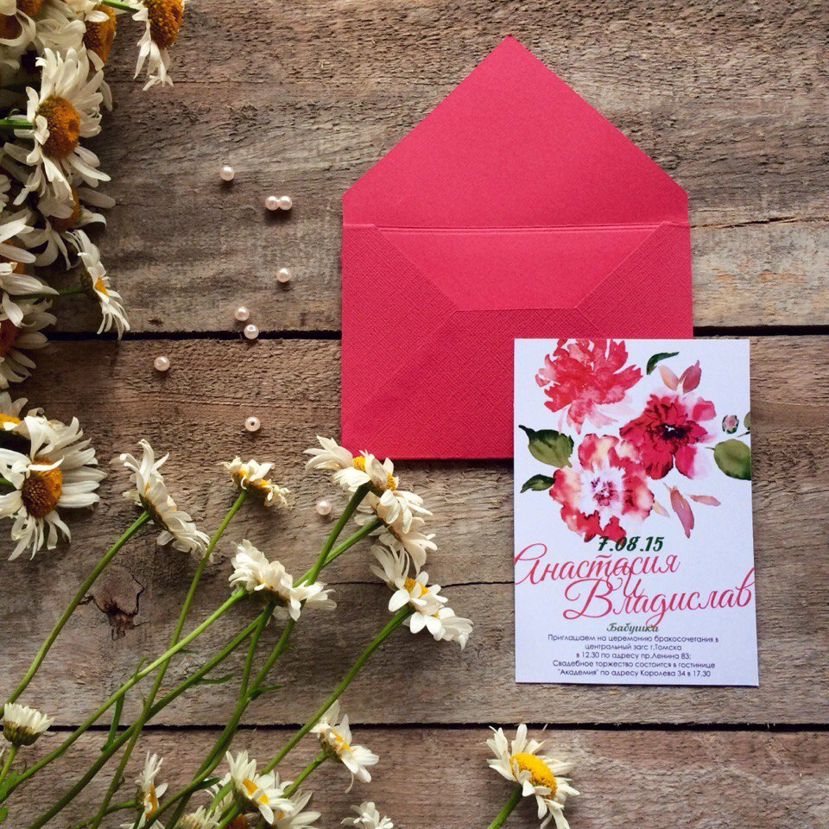
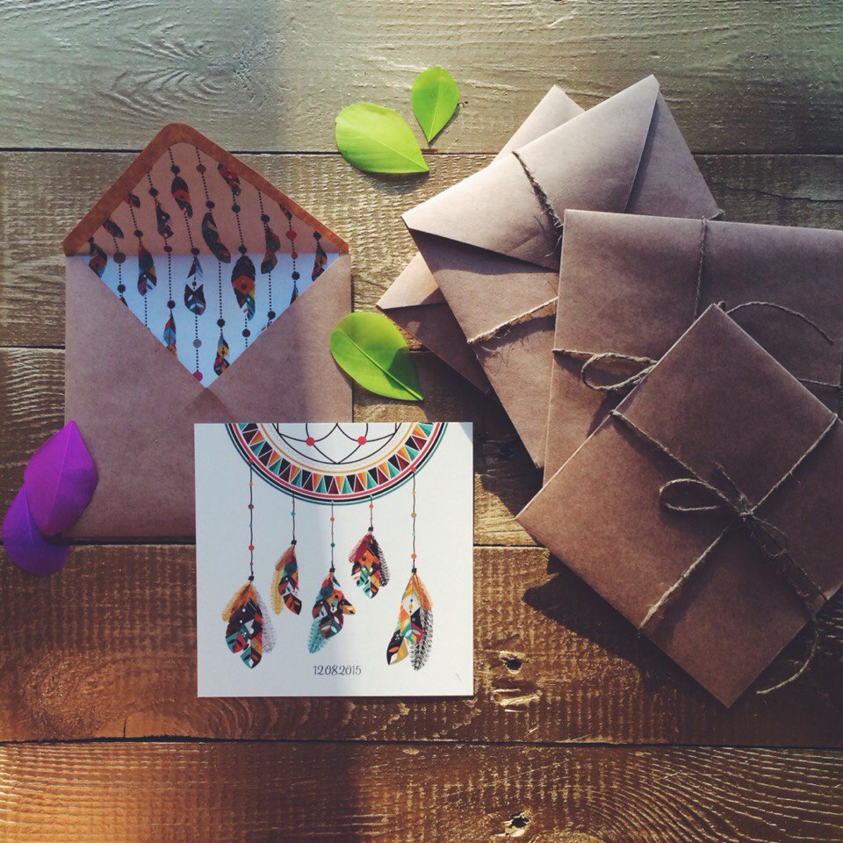
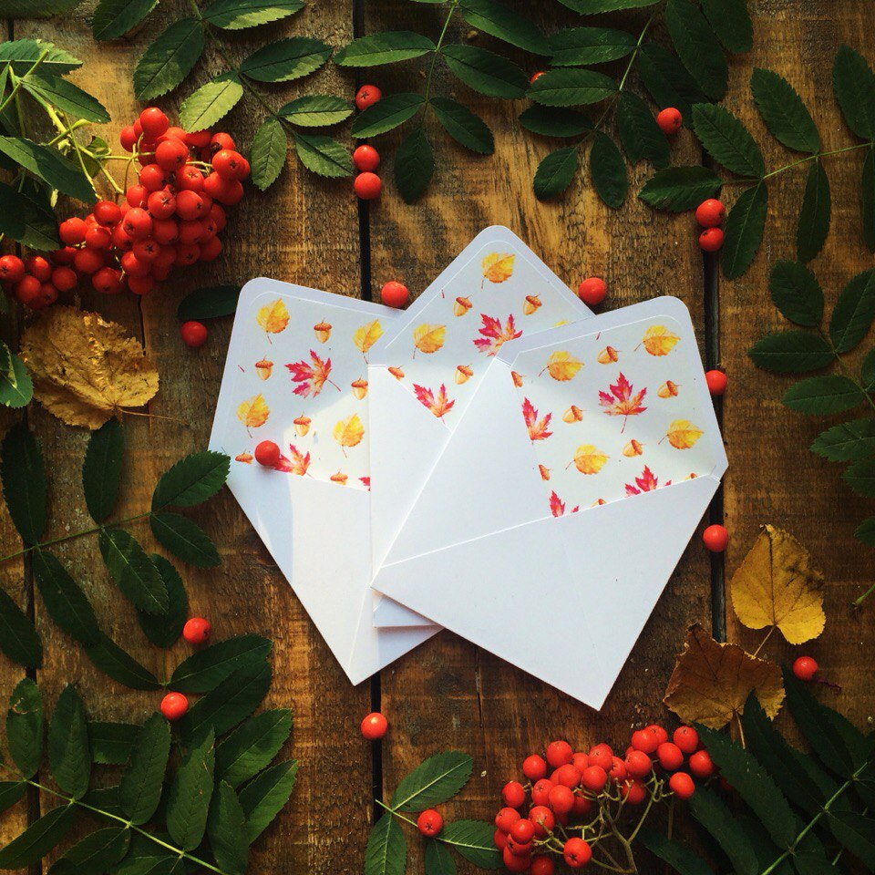
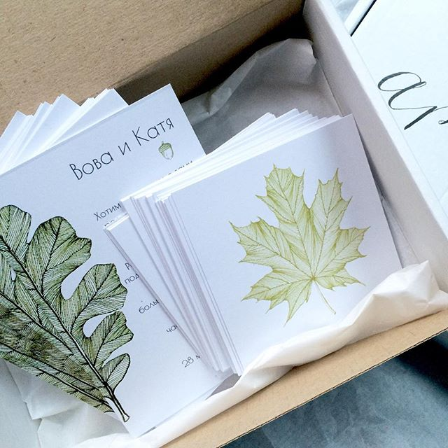
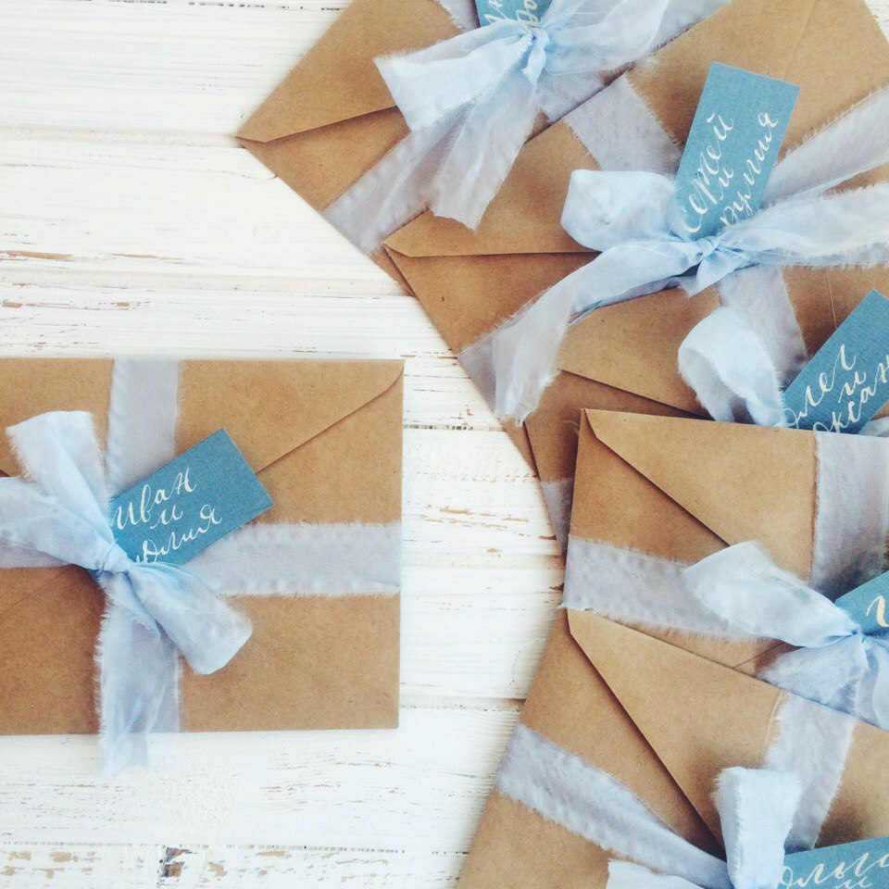
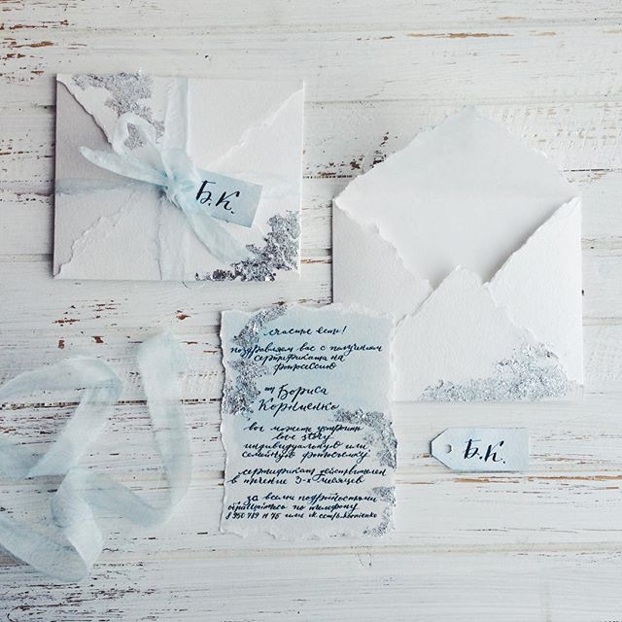
Wedding invitations design, 2015-2016
Projects Wedding polygraphy

Slide 17
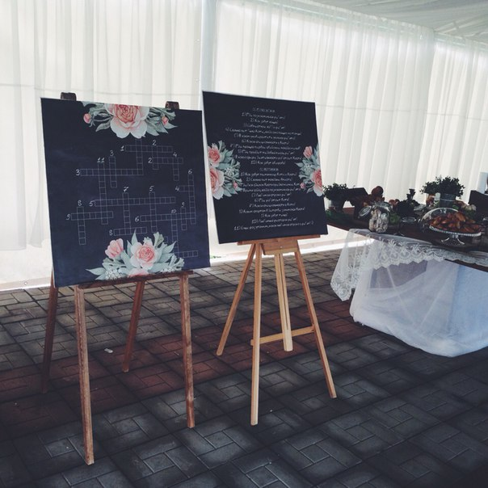
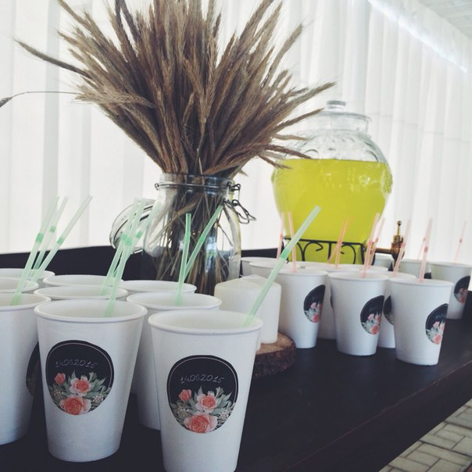
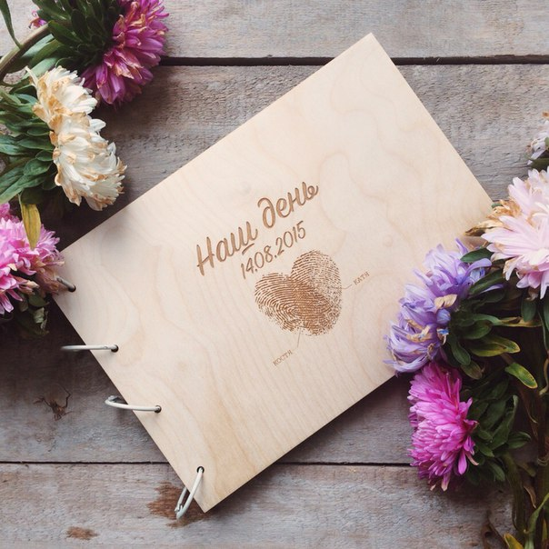
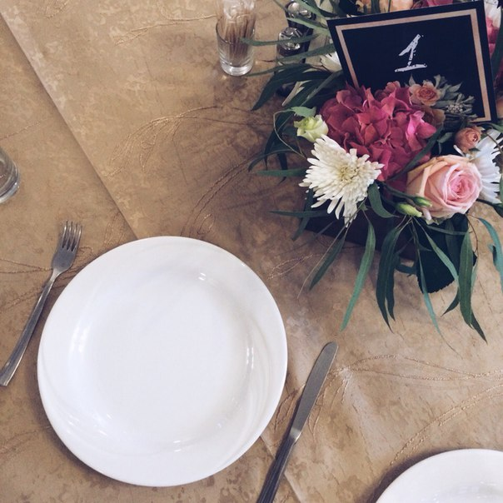

Projects Wedding polygraphy

Slide 18





Projects Photo albums
Different materials and different content

Slide 19





Projects Craftsmaking

Slide 20

THANK YOU FOR YOUR ATEN
TTION

